Slide 1
Server for IoT devices and Mobile devices using Wifi Network
Joaquin berenguer
30 minutes

Slide 2
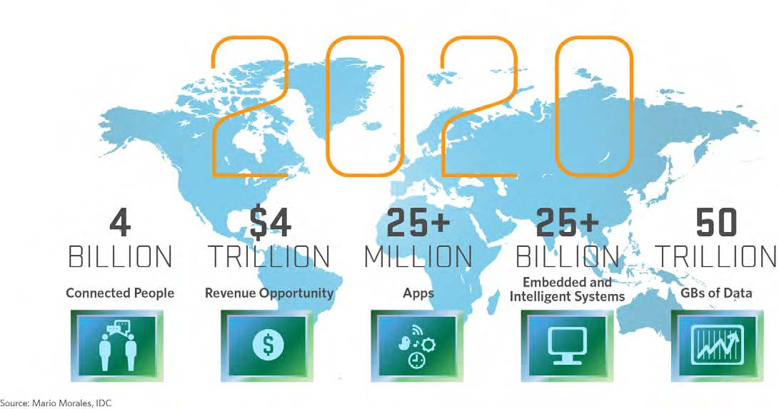
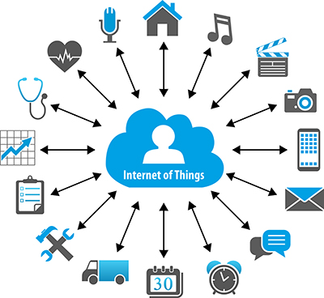
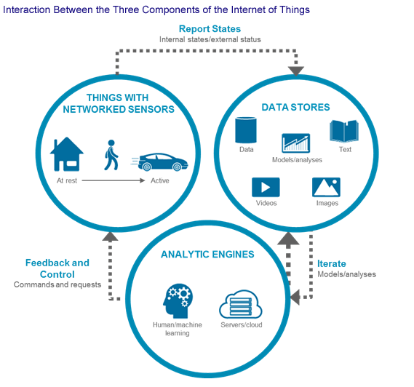
Images of IoT

Slide 3
Content
Environment
Architecture
Server Functionality
Security
IoT Devices
Mobile and Desktop Devices
Alarms, Sensors, Actuators
Future

Slide 4
PYTHON ENVIRONMENT : WINDOWS or Linux
Python 3.5.1
Standard Libs : os, sys, tkinter, hashlib, serial, time, datetime, signal, socket, random, threading, queue, sched, socket.io-client, flask, flask-socket.io
MySQL Lib : mysql.connector (mysql-connector-python-2.1.3.zip) (Platform Independent (Architecture Independent), ZIP Archive, ver 2.1.3) to use Python 3.5.1, only 3.4 available as per today.) (AT : http://dev.mysql.com/downloads/connector/python/)
Pure Python Personal Libs : MyFunc16 (mysql functions), MyConfig (system config), ChimoFunc16 (general functions), USBFunc16 (USB Messaging).

Slide 5
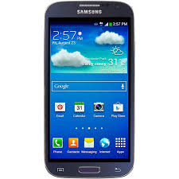
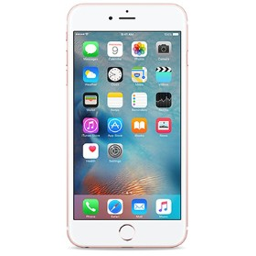
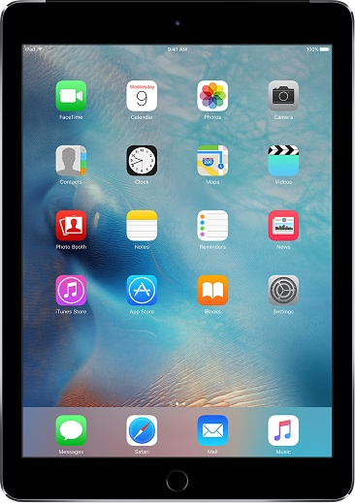
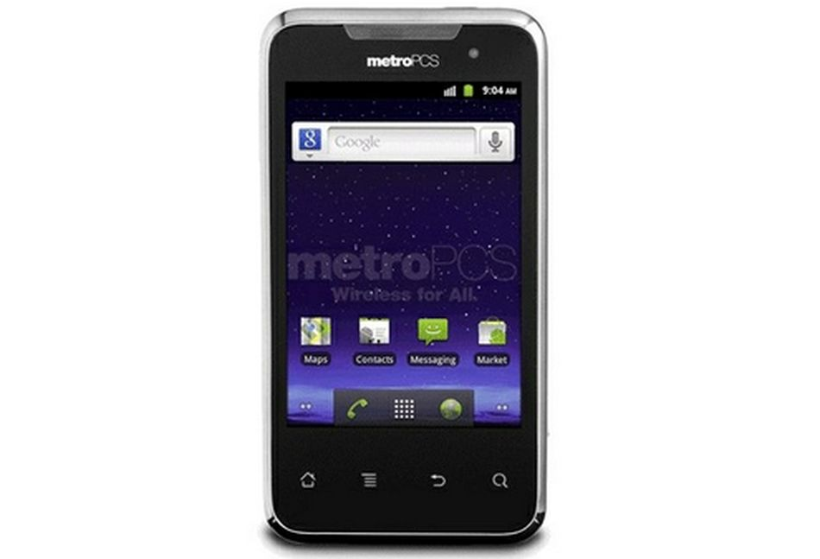
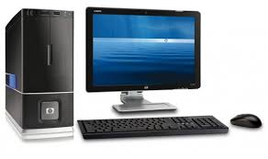

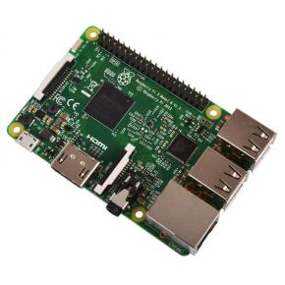
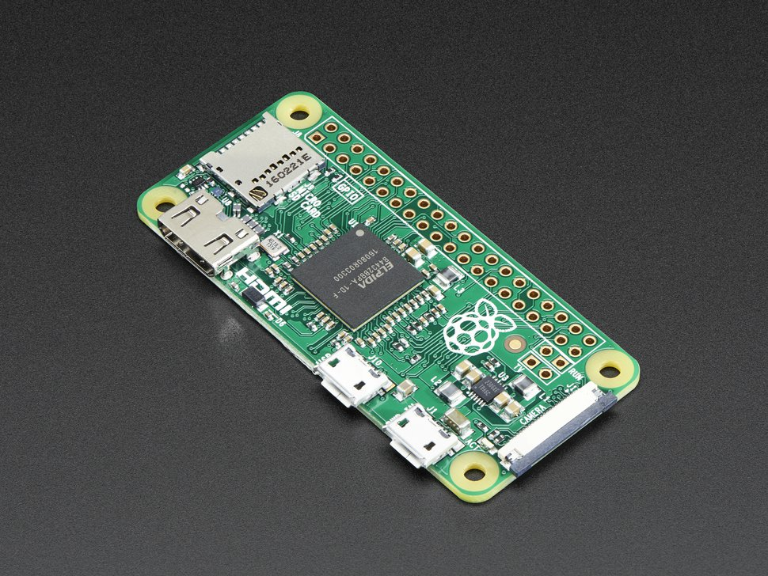
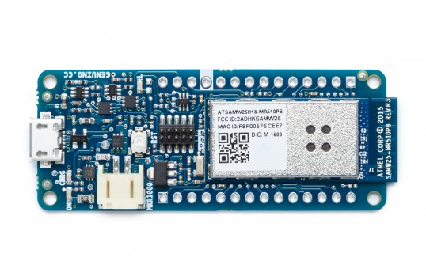
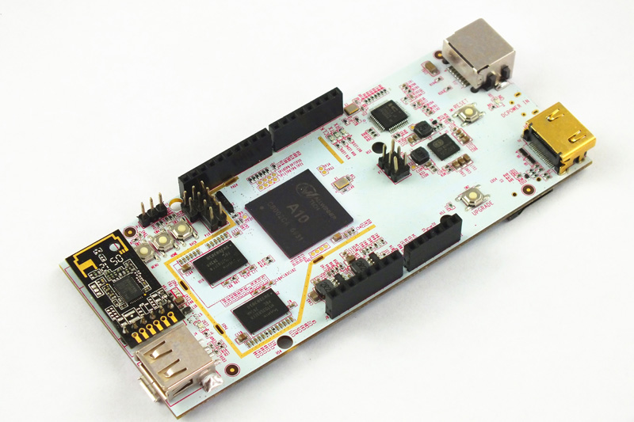
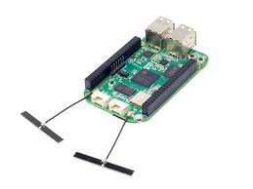
Aquitecture
This is not a PaaS
Like Xively (LogMeIn
or ThingSpeak (Mathworks)!!!
Flask + SocketIO
IoT Server

Slide 6
FLASK + SOCKET-IO App.
FrontEnd App. To show the Server Functionality
Any Browser or OS, that support Websockets is valid.
Flask App. Acts as several (load depending) modules connected to IoT Server
Events from Modules are sent to the Flask App. Using SocketIO_Client Python Library.
Messages to Modules are made using http://cdn.socket.io/socket.io-1.4.5.js

Slide 7
IoT Server Architecture
Thread + Queue + Socket = Device Connected
Server Process, waiting for TCP connections , starting threads x N
MySQL 5.7 Server or MariaDB 10.0.3

Slide 8
Devices communication process
Thread 1
Thread i
Thread i + 1
Thread n
1
8
5
4
…
…
6
7
3
2
Queue1
Queue i
Queue i+1
Queue n
…
…

Slide 9
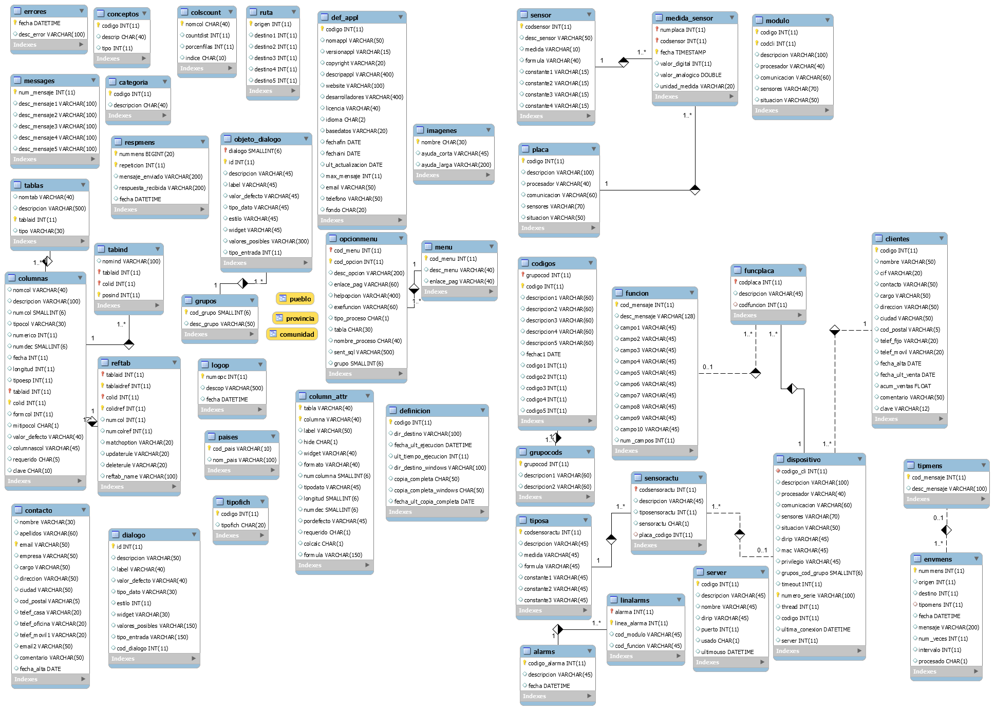
MySQL 5.6, Data MODEL

Slide 10
Parameters to define a device (I)
To register the device before being used by the end user, the IoT device is configured storing in THE DEVICE memory the following parameters, using his USB connection :
Type of Device, Id of the Device, Serial Number, Server Name and Server Port are stored in flash memory of the device and in the database at the same time.
The Serial Number NEVER is transmited between Server and Any device.
Different Servers could be used if the number of devices is incremented, this will change the Server Port in the device.
The architecture could have as many servers that could be needed and one database.
Actually the server name is public using dynamic dns based on no-ip.

Slide 11
Parameters to define a device (II)
The end user, will use USB and the program provided to store in the device the name of the wifi network and password.
With this information, the Module will connect to the server and will be ready to receive and send messages.
Each device will have registered what kind of messages could manage.
And the server will have which device could send messages to which device.

Slide 12
Device thread
Each Device IoT, Mobile or Desktop, have assigned a thread, a socket and a queue.
Used : socket.recv with timeout or queue.get if queue not empty to manage a message that have arrived from a registered device.
Socket.send and queue.put to send messages from server to the Device or to a different thread.
Used a Semaphore for critical situations like global number of messages.
The thread assigned needs to identify the device in two steps :
First message received : Type of Device and Id of the device, Server send thread number to the device, this number will identify the messages for that device.
Second message received : Digest of Serial Number + Random Number and Random Number, digest is build using SHA256. Serial Number NEVER is sent between Server and Device to avoid problems.
If success, thread is ready to receive and send messages to the device, if not, thread is terminated.
Every Device have a defined timeout that terminate the thread if not sent any message during that period.
IoT Device will reconnect when needed.

Slide 13
A Queue for each Thread
Each Thread have assigned a queue, that is used to communicate different threads.
The communication between devices is implemented sending messages between different threads using a queue.
Always using the Origin of a message that identify a thread and the Destination Field of the message that identify the Destination Thread and his queue. That finally identifies the device.

Slide 14
Message format
The 3 first fields are mandatory : Device Origin, Device Destination and Message Type.
The rest of the fields depend on the Type of Message.
Each Field have variable length, and use a separator field.
Each Message is finished by ASCII_EOT to indicate end of message.

Slide 15
security
Used SHA256 in both parts of the communication to identify the devices registered.
The database store in a table the devices registered with 3 columns that is needed for the connection : Type of Device, Id and Serial Number. Serial Number never is sent in any trasmission.
In the first step Server will receive Type of Device and Id, getting the Serial Number from the Database.
The Random Number is generated in the IoT device using srand(value of timer) with a timer value in the moment of calculation and rand() function. A number of 5 digits is generated. In the case of using Python, random lib is used.
The device will send the digest of Serial Number + Random Number, and the random number.
The Server using the serial number stored in the database, and the random number provided by the device, will calculate the digest and if the result is correct, the device is registered to receive and send messages, if not, the thread is terminated.
In Python the library hashlib.sha256 is used, in C the implementation of sha256 is made based on Atmel documentation. And the usage of Cryptographic devices like ATECC508.
The Devices are grouped by customer, only devices of the same group could send and receive messages among them.

Slide 16
IOT Device low consumption
MKR1000
Actually based on ATSAMD21J18 (64 pins) and ATSAMD21G18 (48 pins) from Atmel. Arm Cortex M0+, 32 bits with 256KB of Flash and 32K of RAM.
Wifi Module : WINC1500 from Atmel.
Crypto Device ATECC508, SHA204.
Battery Management with MCP73831T, 1 cell Li-Po
Possibility to add SPI Ram and Flash Memory.
Any type of Sensor and Actuator could be used, each Project will have the own specific design.
Atmel Studio 7 for Development, using C language. Atmel-ICE to debug and program the ATSAMD21 and Arduino 1.6.8 for MKR1000 in Basic Programs

Slide 17
ATSAMD21
ARM Cortex-M0+ Processor
ATSAMD21J18 : 64 pins, 256KB Flash, 32KB RAM
ATSAMD21G18 : 48 pins, 256KB Flash, 32KB RAM
High Performance : 48MHz operation, 2.14 CoreMark/MHz, Single-cycle IO Access, Up to 12-channel event system, Up to 12-channel DMA.
Low power : < 70μA/MHz, <3.5μA RAM retention and RTC, Internal and external oscillators, On-the-fly clock switching and prescaling.
Robust peripheral set : Up to six serial communication modules (SERCOM) configurable as UART/USART, SPI or I2C, (8 in J and 6 in G) 16-bit Timer/Counters, 32bit timer combining 2 of 16bits, Peripheral Touch Controller that supports buttons, sliders, wheels and proximity with (256 in J and 120 in G) channels, Real Time Clock (RTC) and Calendar with leap year correction and 1ppm calibration, (20 ch in J and 14 ch in G) 12-bit 350ksps ADC and 10-bit DAC, Full Speed USB device and host, 2-channel I2S (Inter-IC Sound Controller (I2S) provides a bidirectional, synchronous digital audio link with external audio devices), GPIO : (54 in J and 38 in G)
Timers/Counters for Control : 3 of them are Timers/Counters for control applications like switch mode power supplies, lighting and motor control. The T/CCs support up to 96MHz and 24 bit resolution.

Slide 18
Iot Boards that could be used, today with this server
Using SAMD21G18 (48pins) we have the next 5 boards. Rest are using 64pins.
Arduino Zero + (ESP8266 or WINC1500) (52€+5€ or 52+15€)
Arduino Wifi Shield 101 (WINC1500+Crypto (No CPU)) (50$) (USA ONLY)
Arduino MKR1000 (ATSAMW25) (38€)
SparkFun SAMD21 Mini Breakout + (ESP8266 or WINC1500) (20€+5€ or 20€+15€)
Adafruit SAMD21 + WINC1500 (39€)
Atmel ATSAMW25, that is the core of MKR1000, to build a new Board.
BerentecD21 (25€) (including SAMD21J18+ESP8266+Crypto)
BerentecD21-2 (39€) (with WINC1500 instead of ESP8266)
BerentecW25 (30€)

Slide 19
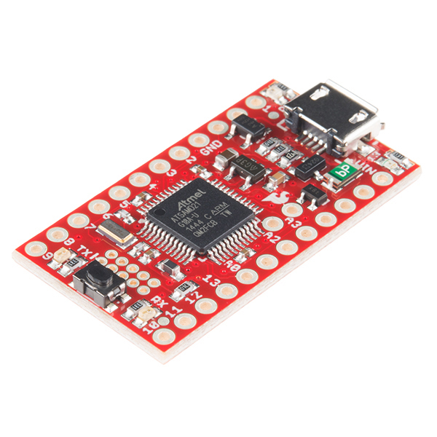
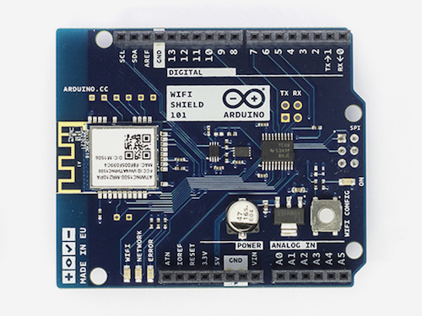
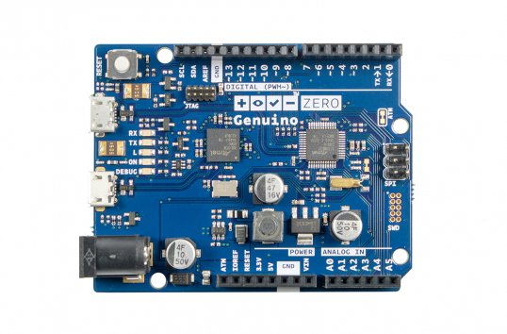
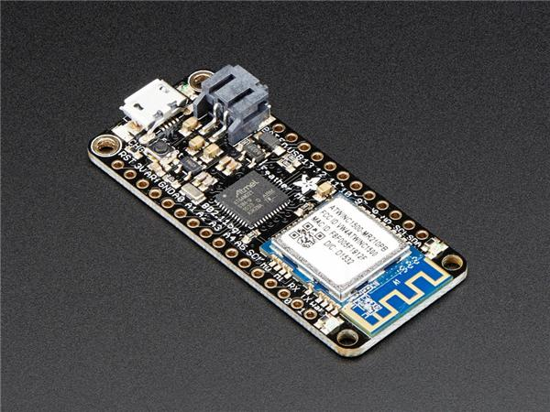
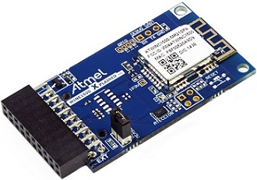
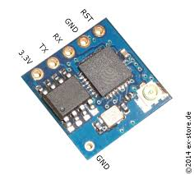
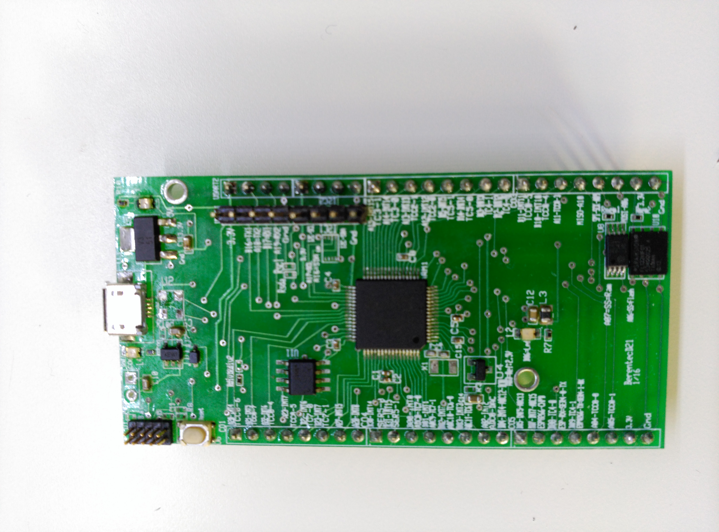
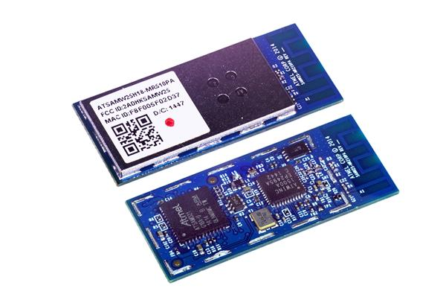
Modules boards
Sparkfun
ESP8266-05
Adafruit
WINC1500
MKR1000
BerentecD21
ATSAMW25

Slide 20
WIFI RANGE
In a normal laptop the power transmitted is about 15dBm (32mW), a normal receiver is using -70dBm (100pW).
WINC1500 is transmitting 18,5dBm and receiving -98dBm, 802.11b, 1Mb/s
With 20dBm more than 100 meters range could be made, at the worst case like at home. More than 1000 meters in open air.
Tipical Calculation gives around 1Km for this devices in Open Air.
Wireless Range Calculation : PathLoss=Pt-Pr-AntGain-Losses-FadeMargin, Fade Margin for a bad situation could be 25dBm, AntGain=2dBm -> PatLoss is about 90dBm
Distance in Km = 10^((90-100,22)/20) for 2,45GHz -> about 300 meters
Notes:
dBm to Watt, mW, dBW conversion table
Power (dBm)Power (dBW)Power (watt)Power (mW)-100 dBm-130 dBW0.1 pW0.0000000001 mW-90 dBm-120 dBW1 pW0.000000001 mW-80 dBm-110 dBW10 pW0.00000001 mW-70 dBm-100 dBW100 pW0.0000001 mW-60 dBm-90 dBW1 nW0.000001 mW-50 dBm-80 dBW10 nW0.00001 mW-40 dBm-70 dBW100 nW0.0001 mW-30 dBm-60 dBW1 μW0.001 mW-20 dBm-50 dBW10 μW0.01 mW-10 dBm-40 dBW100 μW0.1 mW-1 dBm -31 dBW794 μW0.794 mW0 dBm-30 dBW1.000 mW1.000 mW1 dBm-29 dBW1.259 mW1.259 mW10 dBm-20 dBW10 mW10 mW20 dBm-10 dBW100 mW100 mW30 dBm0 dBW1 W1000 mW40 dBm10 dBW10 W10000 mW50 dBm20 dBW100 W100000 mW60 dBm30 dBW1 kW1000000 mW70 dBm40 dBW10 kW10000000 mW80 dBm50 dBW100 kW100000000 mW90 dBm60 dBW1 MW1000000000 mW100 dBm70 dBW10 MW10000000000 mW
Suppliers usually determine range by deriving it empirically from real-world tests or by using a calculation. Either approach is fine as long as you account for all variables. An empirical solution, however, may reveal real-world situations that calculations don’t address.
Before we compare the approaches, let’s define a few terms to understand a manufacturer’s numbers or relevant variables for range.
Power And dBm Calculations
RF power is most commonly expressed and measured in decibels with a milliwatt reference, or dBm. A decibel is a logarithmic unit that is a ratio of the power of the system to some reference. A decibel value of 0 is equivalent to a ratio of 1. Decibel-milliwatt is the output power in decibels referenced to 1 mW.
Since dBm is based on a logarithmic scale, it is an absolute power measurement. For every increase of 3 dBm there is roughly twice the output power, and every increase of 10 dBm represents a tenfold increase in power. 10 dBm (10 mW) is 10 times more powerful than 0 dBm (1 mW), and 20 dBm (100 mW) is 10 times more powerful than 10 dBm.
You can convert between mW and dBm using the following formulas:
P(dBm) = 10 · log₁₀(P(mW))
P(mW) = 10^{(P(dBm)/10)}
For example, a power of 2.5 mW in dBm is:
dBm = 10log2.5 = 3.979
or about 4 dBm. A dBm value of 7 dBm in mW of power is:
P = 10^{7/10} = 10^{0.7} = 5 mW
Path Loss
Path loss is the reduction in power density that occurs as a radio wave propagates over a distance. The primary factor in path loss is the decrease in signal strength over distance of the radio waves themselves. Radio waves follow an inverse square law for power density: the power density is proportional to the inverse square of the distance. Every time you double the distance, you receive only one-fourth the power. This means that every 6-dBm increase in output power doubles the possible distance that is achievable.
Besides transmitter power, another factor affecting range is receiver sensitivity. It is usually expressed in –dBm. Since both output power and receiver sensitivity are stated in dBm, you can use simple addition and subtraction to calculate the maximum path loss that a system can incur:
Maximum path loss = transmit power – receiver sensitivity + gains – losses
Gains include any gains resulting from directional transmit and/or receive antennas. Antenna gains are usually expressed in dBi referenced to an isotropic antenna. Losses include any filter or cable attenuation or known environmental conditions. This relationship can also be stated as a link budget, which is the accounting of all gains and losses of a system to measure the signal strength at the receiver:
Received power = transmit power + gains – losses
The goal is to make the received power greater than the receiver sensitivity.
In free space (an ideal condition), the inverse square law is the only factor affecting range. In the real world, however, the range also can be degraded by other factors:
• Obstacles such as walls, trees, and hills can cause significant signal loss.
• Water in the air (humidity) can absorb RF energy.
• Metal objects can reflect radio waves, creating new versions of the signal. These multiple waves reach the receiver at different times and destructively (and sometimes constructively) interfere with themselves. This is called multipath.
Fade Margin
There are many formulas for quantifying these obstacles. When publishing range numbers, however, manufacturers often ignore obstacles and state only a line-of-sight (LOS) or ideal path range number. In fairness to the manufacturer, it’s impossible to know all the environments where a radio may be used, so it’s impossible to calculate the specific range one might achieve. Manufacturers will sometimes include a fade margin into their calculation to provide for such environmental conditions. Thus, the equation for distance calculations becomes:
Maximum path loss = transmit power – receiver sensitivity + gains – losses – fade margin
Fade margin is an allowance a system designer includes to account for unknown variables. The higher the fade margin, the better the overall link quality will be. With a fade margin set to zero, the link budget is still valid, only in LOS conditions, which is not very practical for most designs. The amount of fade margin to include in a calculation depends on the environment in which the system is expected to be deployed. A fade margin of 12 dBm is good, but a better number would be 20 to 30 dBm.
As an example, assume a transmit power of 20 dBm, a receiver sensitivity of –100 dBm, receive antenna gain of 6 dBi, transmit antenna gain of 6 dBi, and a fade margin of 12 dB. Cable loss is negligible:
Maximum path loss = transmit power – receiver sensitivity + gains – losses – fade margin
V – maximum path loss = 20 – (–100) + 12 – 12 = 120 dB
Once the maximum path loss has been found, you can find the range from the formula:
Distance (km) = 10(maximum path loss – 32.44 – 20log(f))/20
where f = frequency in MHz. For example, if the maximum path loss is 120 dB at a frequency of 2.45 GHz or 2450 MHz, the range will be:
Distance (km) = 10^{(120 – 32.44 – 67.78)/20} = 9.735 km
Figure 1 shows the relationship between the maximum path loss and range at a frequency of 2.45 GHz.
Interpreting Empirical Results
While empirical methods are very useful in determining the range, it often is difficult to achieve ideal LOS for real-world measurements and difficult to understand how much fade margin to build into a system. Measured results can help identify issues beyond RF propagation that may affect the range of a system, such as multipath propagation, interference, and RF absorption. But not all real-world tests are the same, so real-world measurements should be used primarily to bolster the link budget numbers calculated above.
Factors that can influence the range achieved in an empirical test include antenna gain, antenna height, and interference. Antenna gain is a key source of gain in the system. Often manufacturers will certify their radio to work with different types of antennas from high-gain Yagi and patch antennas to more moderate-gain omnidirectional antennas. It is important to ensure tests were performed with the same type of antenna with which you are now using the radio. Changing from a 6-dBm antenna to a 3-dBm antenna on both the transmit and receive side will cause a 6-dBm difference in the link budget and reduce the range by half.
Antenna Height And The Fresnel Zone
Antenna height is another concern for empirical measurements. Raising the height of an antenna does two main things. First, it can help get you above any possible obstructions like cars, people, trees, and buildings. Second, it can help get your true RF LOS signal path at least 60% clearance in the Fresnel zone.
The Fresnel zone is an ellipsoid volume between the transmitter and receiver whose area is defined by the wavelength of the signal. It is a calculated area that strives to account for the blockage or diffraction of radio waves. It’s used to calculate the proper clearance a signal should have around obstacles to achieve optimal signal strength. A general rule of thumb is to have the LOS path clear above the obstacles that are no more than 60% of the antenna height.
The curvature of the Earth can also impact LOS for long-range wireless links. The table provides some examples of the impact, where the Earth’s height at the midpoint of the link path does not account for hills or other terrain features and the antenna height achieves a signal that is at least 60% in the Fresnel zone.

Slide 21
WIFI MODES
Station (normal mode with the server), usually only this mode is used.
Soft AP (used a server, or range extensión)
Http Provisioning (WINC1500 only)
Wifi Direct (WINC1500 only)

Slide 22
ESP8266 VS. WINC1500
Parameter | ESP8266 | WINC1500
Price | 4€ | 12€
Power Transmited | 20dBm | 18,5dBm
Sensitivity | -91dBm | -98dBm
Interface | USART | USART and SPI
Data Transmission | 802.11b, 1Mb/s | 802.11b, 1MB/s
Consumption On Transmit | 170mA | 22mA
Consumption on Receive | 50mA | 22mA
Consumption On Only | 1mA | <10microA
Consumption PowerDown | <60microA | <3,5microA
Type of Antenna | PCB Trace, U.FL | PCB Trace, U.FL

Slide 23
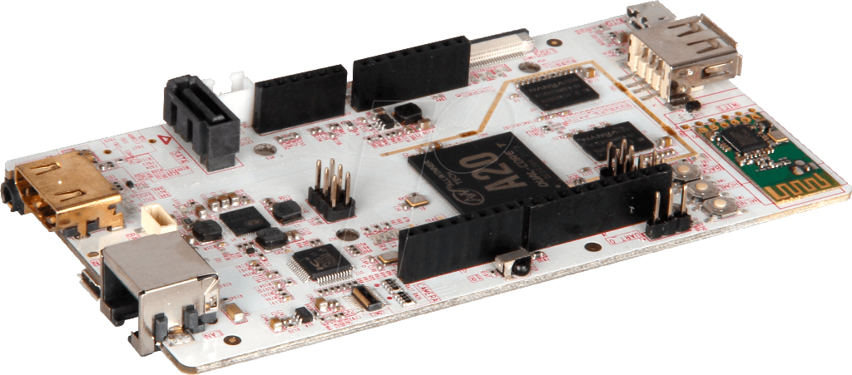
Iot Advanced Modules
Linux Embedded Boards like RaspberryPi 3, that integrate Wifi Module, could be an IoT Device for Advanced Applications (45€). Including Open CV Applications, using the camera that could be incorporated. Python easy to use. New RaspBerry Zero + Wifi Dongle for 15€ is fantastic as well. Limited usage for Industrial, limited permissions, to be used for Media and Education
Ubuntu Embedded Boards as PcDuinoWifi (30$) or PcDuino3 (50$), with Wifi modules, easy to use, with Python easy to use
BeagleBone Green Wireless, 44$, should be used to build comercial products, specially for Industrial environment. Debian or Ubuntu OS
PcDuino
BeagleBone Green wireless
RaspBerry3
Raspberry Zero

Slide 24
Mobile and Desktop Device
Any web browser in any OS that support Websockets could be used.
From any device and any OS, to use Flask + SocketIO, is the best way.
For any type, Access to Server will have the same process as the IoT Device, and App. Will have the possibility to select which IoT Device is selected to send messages.

Slide 25
Alarms and events
SocketIO is being used for start-stop alarms, and to define events on the modules, using the Flask Application.
Alarms are defined by sending messages to each device or group of devices. The messages are sent by the Server. End User could implement alarms sending those messages to the server.
The device by interrupt will capture the alarm and send a message to the Server, who will resend the message to the devices registered in the Server for that Alarm and store the message in the DB .
Events are Scheduled messages sent by the server to any device to read sensors, and take decisions according to a group of variables to make actuators work, and advise to the mobile devices of decisions taken.

Slide 26
Sensors
Any type of sensor that is connected to a Device could be read. By sending messages to the corresponding device, from any mobile or desktop app. That is registered in the Server and that could Access to that device.
Sensors like : Temperature, Ambient Humidity, Pressure, Presence, Light, Water Level, Position, Distance, Giroscope, Gravity, Rotation, Acceleration, …
Two types of Reading, send a message to read a sensor in a determined moment or register an alarm for a sensor, and receive the Reading when a determined value have been set.

Slide 27
Actuators
Any write from the device, is going to be named as Actuator, into this group we could have from a led or lamp. To Motor velocity or acceleration.
Sensor Alarm, also could actívate the actuator, to avoid sending messages to the server and comeback.
The end user Application, need to be developed in the Device and configure the server to arrive to the solution required by the customer.

Slide 28
FUTURE
Software is the most important part of the Solution.
Many Applications could be developed around IoT, we are at the beginning of a new business sector.
Products as Xively from LogMeIn, ThingSpeak from Mathworks, Azure from Microsoft are good examples.
Hardware will continue to integrate more parts of the Application, decreasing the Price and size at the same time.
Sophisticated Wearables will be part of the Solution in the near future.
Industry will take advantage as well, substituting actual solutions.

Slide 29



Thank You!!!
Joaquin Berenguer
joaquin@berentec.com
https://github.com/joaquinbb
607712474

